Slide 1
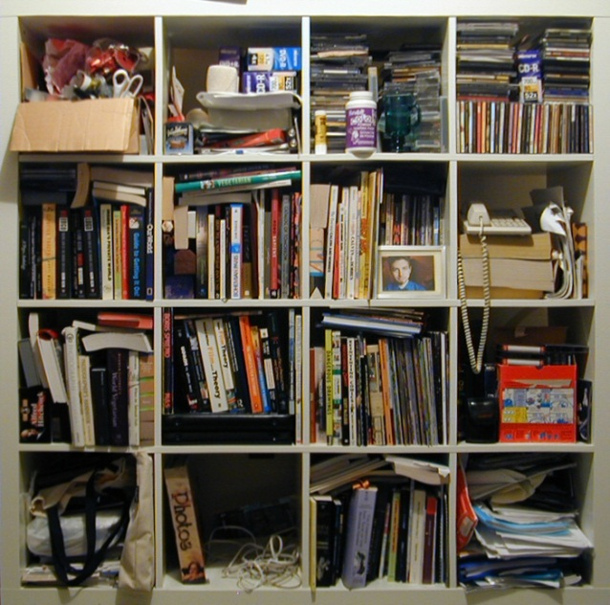
the Repository at St. Cloud State University
Benefits of an institutional repository
Notes:
Keith Ewing

Slide 2
What is The repository?
A digital collection of the intellectual output of students, faculty, administrators and others who are members of the University community.
Expression of institutional vitality
Contribution to a growing network of open access scholarship
Puts faculty and students in the mainstream of scholarly activities.
Notes:
What is a “digital collection”?
-- Can include almost anything, including text (pre-prints, post-prints, white papers, reports, theses, dissertations), images (photos, artwork), audio (presentations, lectures), presentations (PPT), video (presentations, lectures)
-- An IR is digital collections of the intellectual output of the University. For the most part, the focus is on research output—the scholarly activity of students (e.g., Research Colloquium papers and presentations, honors theses, etc.; master’s theses and doctoral dissertations) and faculty (pre-prints, post-prints (depending on copyright permissions of publisher), white papers, conference presentations, book chapters, books, etc.). IRs often contain scholarship by non-University people who present at a campus-based conference, workshop, or institute (e.g., the Economics Dept Winter Institute).
-- Some depositories focus on a single or group of disciplines from multiple institutions (e.g., SSRN (http://www.ssrn.com/), RePEc (http://ideas.repec.org/), ArXiv (http://arxiv.org/, etc.) or publication type from multiple institutions (e.g., NDLTD (http://www.ndltd.org/).
-- Institutional repositories focus on the output of a single institution.
-- It does not hurt, and often both expands discovery+access and improves sustainability, to deposit in multiple repositories, e.g., a disciplinary and institutional repository in addition to a proprietary publisher site.
-- An IR is often organized by academic unit (college, school, department, center), by author, and is searchable—both within the repository and more widely through Google or Google Scholar.
To put SCSU in the mainstream of open access scholarly communication.
What is “Open Access”?
--Open Access is “immediate, free availability on the public Internet, permitting any users to read, copy, distribute, print, search or link to the full text of these articles, crawl them for indexing, pass them as data to software, or use them for any other lawful purpose.” (Budapest Open Access Initiative, as quoted by SPARC, http://www.arl.org/sparc/openaccess/)

Slide 3
What content should be included The repository?
Students:
Master’s theses
Doctoral dissertations
Honors theses
Research Colloquium papers
Faculty:
Pre-prints or Post-prints
Working papers
Book chapters or Books
Conference presentations
Reports
Institutional:
Position papers
Accreditation self-studies
Annual reports
Non-SCSU:
Papers presented at campus conferences or institutes
To join a growing network of more than 1300 open access scholarly repositories worldwide
Notes:
Why does SCSU need an IR?
-- The expansion of graduate programs, particularly with the addition of doctoral programs, requires us to rethink how theses and dissertations are “published.”
-- An IR reduces the cost of binding 3 copies and microfilming; reduces the cost of ILL when they are borrowed (frequently); reduces the cost of replacement when the physical coy is lost or stolen (it happens).
-- An IR promotes access by being indexed through Google/Google Scholar—making your scholarship easier to find and use; open access allows you to have a larger potential audience for you scholarship and can increase the use and impact of your work.
-- A single environment, distinct from the records management function of University Archives, to consistently manage these resources and promote access and use.
Some faculty, e.g., Econ, are already depositing some of their working papers in external disciplinary repsitories – RePEc and SSRN. Added benefit of an IR—deposit the research data as well as the paper built from the data.
Concern: Theses and dissertations will be more widely available and in the public eye. Faculty readers will need to be more aware of potential plagiarism issues and copyright violations as part of the thesis/dissertation review. They will also need to be more aware of writing style and consistency. This could result in better graduate students overall.

Slide 4
Advantages of The repository
Fulfill the vision in Community of Scholars report
Support faculty scholarship through open access to and archiving pre- and post-prints and other scholarship
Promote the idea that our students’ knowledge has value through archiving theses and dissertations and other research
Expand institutional visibility, access, audience, and impact
Showcase the University to prospective students, colleagues, funders, stakeholders
Notes:
Assert author’s ownership (copyright) for intellectual output; see also http://www.openoasis.org/images/stories/file/Copyright%20and%20authors%27%20rights.pdf
For further benefits on an IR and OpenAccess see the pamphlet at http://www.openoasis.org/images/stories/briefing_papers/Institutional_repositories.pdf and for impact of OpenAccess content see http://www.openoasis.org/images/stories/file/Briefing%20papers/Open%20Access%20impact.pdf
In addition to being a showcase, an IR improves external measures of SCSU’s ranking with peers (institutional prestige). For information on SCSU’s ranking among universities in the world (SCSU=1188, MSUMankato=842, UMD=999) see http://www.webometrics.info/region_usacan_select.asp. One of the metrics used is scholarly output based on analysis of Google Scholar and open access sources.

Slide 5
concerns
Authors
Copyright restrictions placed by publishers
Copyright infringements and plagiarism
Ease and control of deposit
Deposit agreement
Usage Statistics
University
Image of the University
Academic dishonesty
Adequate support
Notes:
Author concerns:
-- copyright restrictions placed by publishers. Many scholarly publishers (about 68%) now permit reposting either the pre-print or post-print of scholarship published in peer-reviewed journals in an IR; OpenAccess journals are even less restrictive. A directory of author rights from most scholarly publishers is available at http://www.sherpa.ac.uk/romeo/. As an author, if the publisher does not grant self-arching or presentation in an institutional repository, you can investigate adding an addendum to a publishing contract; see the Science Commons Scholar’s Copyright Addendum Engine at http://scholars.sciencecommons.org/.
-----Other copyright issues exist with multimedia, e.g., performance rights, even image display rights; how are these addressed? Who is responsible for obtaining rights and paying any related fees?
-- scholarly authors want broad dissemination and use of their works (impact over income), publishers want to restrict use back on subscription or payment of access charges (even for ILL and use in course readings – Georgia State University case ongoing)
-- copyright infringement by those who download the content—nearly impossible to control except through monitoring (pricey).
-- ease of deposit process. Relatively few steps are required to upload: article metadata (author, affiliation, article title, citation for published version if any, type of article, etc.) For the immediate future, deposit can be handled by library for articles, by grad studies for theses/dissertations
-- deposit agreement. We are developing and will implement a Deposit Agreement detailing the rights and responsibilities of the author and the University. Author grants a non-exclusive license to archive the work, make it available via open access; author attests that the work is original and does not infringe on intellectual property rights of others or is defamatory or libelous; author agrees that metadata for the content is the property of SCSU and that the metadata can be harvested by search engines.
Ease of deposit: Almost any format can be stored. For texts, either Word or PDF or RTF files are acceptable; the user sees a PDF for download.
Control: What, if any, controls are placed on the right to deposit? What is the balance between academic freedom and institutional image?
Usage statistics, Web pages have counters for number of visits, but few faculty know how often their research is used or even read; based on the number of times a work is downloaded for full viewing, stats are sent via email each month to the author and the repository administrator (Keith). In the first week of use, with only 5 documents loaded, there were 6 downloads.
Preservation: Nothing is permanent; what is important is the probability of future access. While print is more durable, access and distribution is more limited. In the short term, BEPress provides preservation services. SCSU can retrieve content from BEPress at any time or at the end of the contract. MDL, on behalf of the state, spent most of 2010-2011 investigating robust and sustainable digital preservation methods and utilities; a recommendation for the state is forthcoming. An IR is essentially about archiving (rather than publishing), but “archiving for access.”
Shouldn’t be confused with peer review (can be done within BEPress for a conference or journal, but for most faculty publishing is done externally by a journal or society—the IR simply maintains a copy of a peer-reviewed article), with version control (the IR could contain preprints, revised drafts, second editions, etc.; only the accepted, peer-reviewed final draft is the crucial “milestone” in the “embryology of knowledge” (see Steven Harnad’s comments at http://www.openoasis.org/index.php?option=com_content&view=article&id=153&Itemid=313).
Institutional concerns:
--Image: how to balance academic freedom with the need for the university to protect its image as an institution of higher education (e.g., Holocaust denial “scholarship,” explicit or implicit *-ism) and from potential litigation (e.g., libelous or plagiarized content, copyright infringements, etc.)
--Academic dishonesty: how to monitor and resolve incidents of dishonest or falsified research/results
--Adequate support

Slide 6
First steps for the repository
Promote deposit and use of faculty and student scholarship
Establish consistent policies for the preservation and sustainability of digital content
Meet with academic departments to encourage faculty deposits
Work with Graduate Studies to develop support programs for theses and dissertations
Notes:
To promote access: provide consistent metadata (author, title, date, affiliation, event, discipline, etc.) in an open access environment (BEPress DigitalCommons) that can be harvested with common protocols (OAI-PMH) for inclusion in search engines (Google Scholar and potentially MnPALS Plus) for wide and rapid dissemination
To encourage use: promote use of open access (freely available) under Creative Commons copyright licensing; BEPress DigitalCommons
Both of these lower impact and access barriers and promote use (and impact)
Secondary aims:
Establish policies and best practices to address digital asset preservation (fixity, future format migration as standards evolve, etc.) that supports sustainable access into the future
By promoting access and use of faculty/student scholarship and University documents, and addressing the digital asset management and preservation issues, to raise the visibility (profile) and prestige (SCSU’s contributions to the advancement of knowledge) of the University
Overall, BEPress DigitalCommons is not a final solution, but a bridge to an as yet unidentified unified system integrating access to library resources, database content, archival records, and local scholarship (discovery neutral a la Google) where the total cost of ownership can be reduced.

Slide 7
Ensuring Repository Success
Build on the experience of others
Align with the University’s mission
Emphasize the Repository as a University initiative
Support from the President and Provost
Emphasize scholarship first
Notes:
As a late adopter of an IR, we are able to see what has worked and not worked for others.
Align with the University’s mission—enough said.
Emphasize the IR as a University initiative, de-emphasize the Library or ITS as “pushing” the initiative
Support of President and Provost? Done, at least for the need and the goals
Emphasize scholarship first.

Slide 8
Further information
Contact:
Keith Ewing
Office: MC 204-D
Phone: 308-4824
eMail: kewing@stcloudstate.edu
Notes:
Contact me at any time.

Slide 9
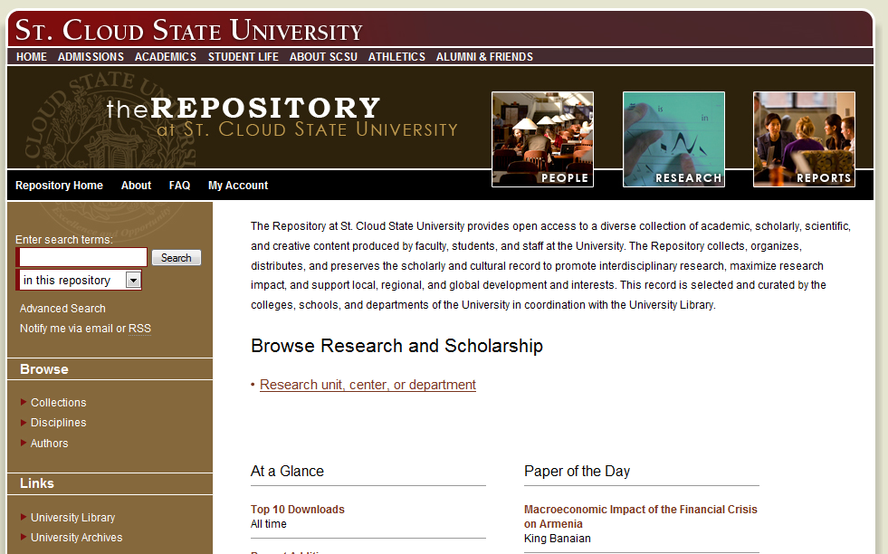
Introducing
http://repository.stcloudstate.edu

